Slide 1
Employee Performance Analysis Using Excel
PRESENTED BY: Blessy B
REGISTER NO : 312204510
DEPARTMENT : COMMERCE
COLLEGE : K.C.S KASI NADAR COLLEGE OF ARTS AND SCIENCE

Slide 2
PROJECT TITLE
Employee Performance Analysis Using Excel

Slide 3
AGENDA
1.Problem Statement
2. Project Overview
3.End Users
4.Our Solution and Proposition
5. Dataset Description
6. Modelling Approach
7. Results and Discussion
8.Conclusion

Slide 4
PROBLEM STATEMENT
"Determine the distribution of employee IDs across performance categories by analyzing the pivot table data. The table shows:
Employee Categorization: The sum of employee IDs in each performance category—'Fully Meets' and 'Needs Improvement.‘
Total ID Values: The aggregated total of employee IDs for each performance category, with a grand total provided.
Data Completeness: Verification of whether all employee IDs are properly categorized and if there are any gaps where IDs are left unassigned (blank).
The outcome of this analysis will help in understanding the distribution of performance ratings among employees and ensure that all data is accurately categorized and complete."

Slide 5
PROJECT OVERVIEW
[Employee Performance Improvement and Pay Zone Optimization]
Accuracy and completeness
Performance and Distribution analysis
Reporting and Recommendations
Data gaps and follow-up

Slide 6
WHO ARE THE END USERS?
Human Resources (HR) Department
Department Managers (Sales & Production)
Senior Leadership/Executives
Employees

Slide 7
OUR SOLUTION AND ITS VALUE PROPOSITION
Filtering - Remove missing values.
Conditional Formatting - Blanks, Background Color Shading, Data Bars, Values.
Data Filtering and Sorting - Identify specific employee groups, such as those with exceeds, needs improvements and fully meets.
Pivot table - Summary of employee performance under their current rating .
Graphs - FINAL REPORT.

Slide 8
DATASET DESCRIPTION
EMPLOYEE ID: Unique identifier for each employee in the organization.
FIRST NAME: The first name of the employee.
Performance Score: A score indicating the employee's performance level (e.g., Excellent, Satisfactory, Needs Improvement).

Slide 9
MODELLING
DATA SET: Kaggle, Employee dataset.
FEATURE SELECTION: Slicer, Conditional Formatting, Designing.
DATA CLEANING: Missing values, Irrelevant data, Correct Errors, Remove Unnecessary Columns and Rows.
PIVOT TABLE: Employee ID, First Name, Pay zone, Department Type, Current Employee Rating.
CHART: Report of Employee Performance based on their Employee Id is represent in Values and Performance Score presented as Column Chart..

Slide 10

RESULTS

Slide 11

CONCLUSION
Distribution of Employee Performance:
The majority of employee IDs (27,856) are categorized under "Fully Meets," indicating a positive performance trend.
A smaller subset of IDs (6,959) falls under "Needs Improvement," which is significantly less compared to those categorized as "Fully Meets."
Data Integrity:
The grand total of all employee IDs (34,815) aligns with the sum of the categorized IDs, suggesting accurate data aggregation.
Performance Insights:
The data suggests that most employees are performing at an acceptable level ("Fully Meets"), while a smaller portion requires improvement.
This distribution indicates a generally strong performance across the workforce, but it also highlights a segment that might need additional support or intervention.

Slide 12
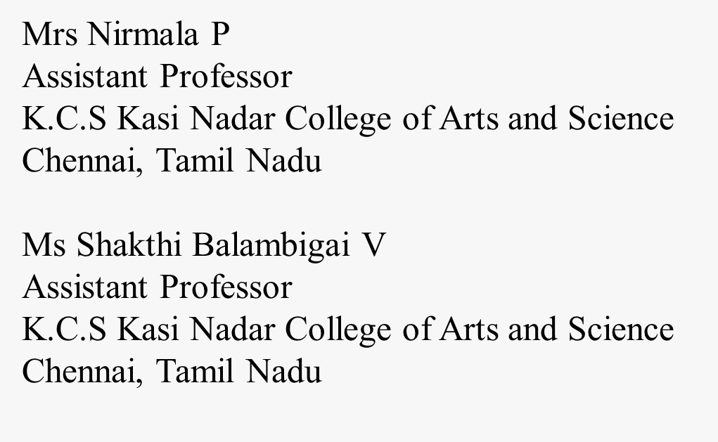
REFERENCE

